Slide 1

IT-648: IT Risk Management
Week 8
Sonja Streuber

Slide 2
Agenda
# | Topic | Reading | Due 11:59 pm CST on Blackboard
8 | Identity and Access Management: Authentication, Single Sign-On, Federation | Agrawal 8 Other materials on Blackboard | W: Post F: Responses S: LAB_8

Slide 3
Chapter 8
Identity and Access Management

Slide 4
Overview
By the end of this week, you will be able to:
Differentiate between identity management and access management
Identify the phases in identity and access management models
Describe the three categories of user credentials
Utilize the relative strengths and weaknesses of the major authentication technologies
Use identity reconciliation as part of the identity management process

Slide 5
Identity management
Definition
Identifying individuals and collating all necessary data to grant or revoke privileges for these users to resources
E.g. Username and password on laptop
Challenges
User churn
Legal requirements
Information unit called a System of Record
SoR
Records from which information is retrieved by the name, identifying number, symbol, or other identifying particular assigned to the individual

Slide 6

System of Record
System of Record (SoR)
Can take various forms: ERP system at large organization, Spreadsheet in small organization
Each unit or function may maintain its own SoR. E.g.
Student SoR
Employee SoR
Student employee?
Information present in multiple SoRs
Identity
Distinct record stored in a SoR
More formal term for “computer user”
Identified by an identifier: String of digits which uniquely identifies an identity in an SoR
Same individual may have multiple identities across the organization-- reconcile monitor individual’s activities within the organization
Done through identity management process

Slide 7
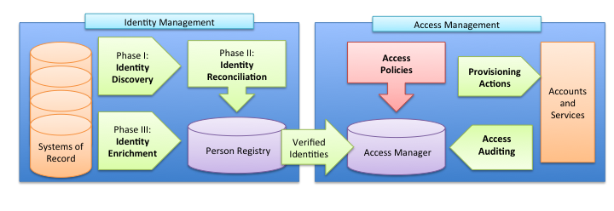
Identity management process
Three stages
Identity discovery
Identity reconciliation
Identity enrichment

Slide 8
Identity discovery
Locating all new and updated identities throughout the organization
Search all SoRs for
Additions
Name changes
Role updates
Corrections to date of birth
Corrections to identifiers
In large organizations
Multiple automated systems
Thousands of pieces of data
Dozens of systems scanned
Several times per day
In small organizations
Done manually at recruitment or termination

Slide 9
Identity reconciliation
Comparing each discovered identity to a master record of all individuals in the organization, e.g., a professor taking a course
Person Registry = Central hub that connects identifiers from all Systems of Records into a single “master” identity
Makes correlation and translation of identity data possible
Faculty
Identifier | First Name | Last Name | Birth Date | Department
13579 | Henry | Jones | 03/13/20 | Archaeology
Student
Identifier | First Name | Last Name | Birth Date | Class
24680 | Henry | Jones | 03/13/20 | Biology 101
Two separate identities are discovered
Identifier | First Name | Last Name | Role
13579 | Henry | Jones | Faculty
24680 | Henry | Jones | Student
Two separate identities are reconciled in person registry
Identifier | First Name | Last Name | Student ID | Employee ID | Birth Date
987654 | Henry | Jones | 24680 | 13579 | 03/13/20

Slide 10
Identity reconciliation
Identity matching
Searching the Person Registry for one or more records that match a given set of identity data
Identity merging
Combining new or updated record with data associated with an existing person record
Identity creation
Creating a new person record and identifier in the Person Registry; invoked when a suitable match is not found in the Person Registry; supplied data is assumed to represent a new person
Also called match/ merge in the industry

Slide 11
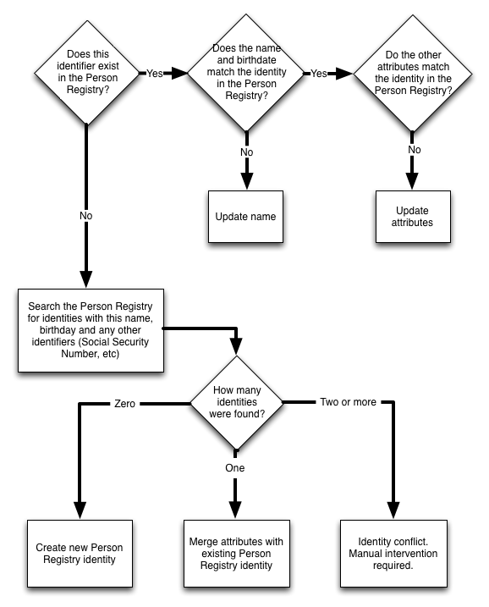
Identity reconciliation – contd.

Slide 12
Identity enrichment
Collecting data about each individual’s relationship to the organization
Example shows adding affiliations
Identifier | First Name | Last Name | Student ID | Employee ID | Birth Date | Roles | Primary Role
987654 | Henry | Jones | 24680 | 13579 | 03/13/20 | Faculty: Archaeology Student: Biology | Faculty

Slide 13
Role
An individual’s relationship to the organization
Individuals often have multiple roles
Faculty member
Student
Administrator
Parent
Primary role
Role that has greatest impact in determining information privileges
Assign priority values to each role
Role with highest priority value is the primary role

Slide 14
Identity management completion
Identity enrichment completes identity management
All information necessary to assign information privileges has been compiled into the person registry
Each individual in the organization is uniquely identified
With reasonable certainty
Provides input to access management system
Handles access decisions and resulting actions

Slide 15
Access management
Role based access control
Granting individuals in specified job roles the access privileges associated with the corresponding system role
Separation of duties
More than one person is required to complete a task
All policies, procedures and applications which make decisions on granting access to resources
Using data from Person Registry and Systems of Record
Common principles

Slide 16
Access registry
A single view of an individual’s accounts and permissions across the entire organization
Also runs periodic access audits
Determining the access each individual should have
Based on
Data provided by the Person Registry
Current security policies
Comparison of access registry data and access audit results
Determine what access should be added or removed
Send provisioning actions to each affected service or system, e.g.
creating accounts
adding permissions
deleting (de-provisioning) accounts
revoking permissions

Slide 17
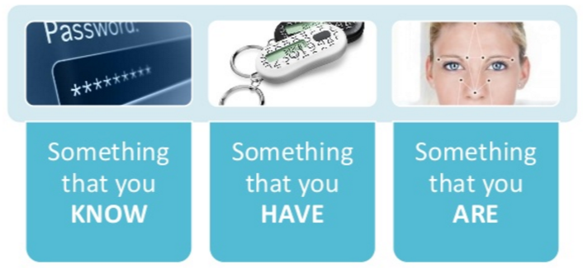
Authentication
The process a user goes through to prove that he or she is the owner of the identity being used
Most commonly done by using credentials
Information used to verify the user’s identity
Types of credentials

Slide 18
Passwords = What You Know
Two common password breaking techniques
Brute-force attacks
Trying all possible character combinations until the password is guessed or every possible combination has been tried
Up to 6-character passwords can be brute-forced in minutes
Dictionary attacks
Trying thousands of passwords from massive dictionaries of common passwords and words from multiple languages
Stolen passwords from insecure sites greatly simplify task

Slide 19
Password Threat Models
Leaked passwords
2009 breach of online games service RockYou
Leaked more than 14 million unique passwords in plain text
Best64.rule
Hackers use heuristics to guess passwords from known passwords
http://www.question-defense.com/2012/04/21/hashcat-best64-rule-details-updated-after-the-best64-challenge
## first four rules ##
# do nothing: :
# reverse each combination: r
# all uppercase characters: u
# toggle the case of char in position 0: T0
## append numbers ##
# append 0 to the end of each combination: $0

Slide 20
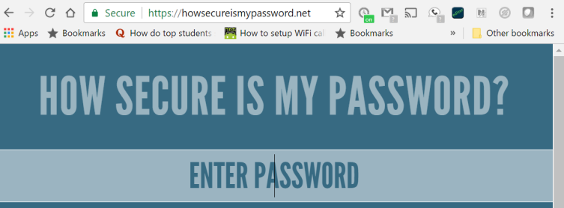
Password recommendations
General recommendations
Minimize accounts
Reduce chances of harvesting
At least 8 characters to prevent brute force attacks
Maximize entropy
Combine lowercase, uppercase, numeric and special characters
Prevent exploitation of harvested passwords
Use passphrases
I LOVE COB USF BULLS
Separation of concerns
Keep financial passwords separate from other passwords
Exercise:
Try:
password
pa$$W0rd
p@$$W0rd*
&p@$$W0rd*
&p@$$W0rd*&
1l0v3mypa$$W0rd

Slide 21
Tokens = What you Have
Physical objects that must be presented to prove the user’s identity
In the case of software tokens, stored on a physical object
In practical use
Almost always combined with a password
“Two-factor” authentication
Simple example
ATM
Debit card (token)
PIN (password)

Slide 22
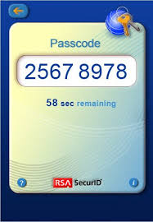
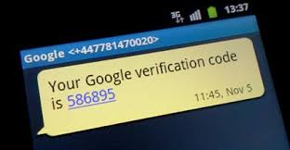
Token types
Smart cards
Store ID
Digital certificate
Require dedicated readers
Hardware tokens
Generate numbers based on a pre-defined sequence
E.g. every 30 seconds
Entered in a conventional form
No new hardware needed
Software based tokens
Smartphone applications that generate number sequences
Text-messaging based tokens
When using a new machine to login
Service sends a number to a pre-registered cell-phone

Slide 23
Biometrics = What you Are
Analyzing the minute differences in certain physical traits or behaviors, such as fingerprints or the pattern of blood vessels in an eye, to identify an individual
Changing technology and its impacts
DNA fingerprinting
Reasonable biometric identification, or unjustified search and seizure?
As costs go down, DNA matching moving towards identification
Fourth Amendment
May 2013 Supreme Court judgment justified on grounds of matching

Slide 24

Biometric markers
Observable physical differences among people
Required properties
Universality - every person should have the trait
Uniqueness - no two people should have the same trait
Permanence - the trait should not change over time
Collectability - the trait should be measurable quantitatively
Performance - accurate measurement should be inexpensive
Acceptability - users should allow measurement of the trait
Circumvention - difficulty of imitating traits of another person

Slide 25
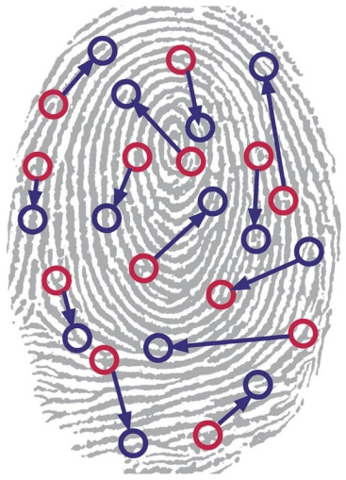
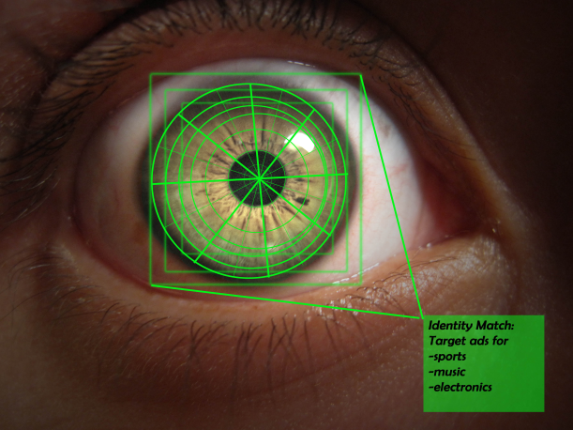
Popular biometric markers
Fingerprints
Unique pattern of ridges on the fingers or palm
Compared based on the shape and location of dozens of uniquely shaped features
Minutiae
Iris scanning
Fast, but less accurate
Retinal scanning

Slide 26
Biometric theft
What happens if a biometric is stolen?
Passwords can be reset
But you cannot reset a fingerprint
Cancellable biometrics
Use encryption controls
Hash functions
Save hash of biometric
Never save actual biometric itself
If stolen
Rehash the biometric

Slide 27
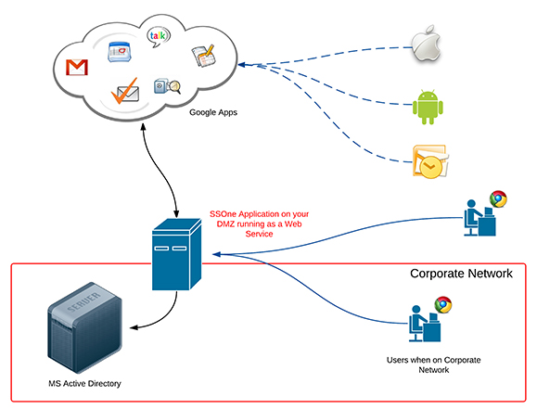
Single Sign-On (SSO)
Ensuring that user has the same username and password in all systems
Implementation
System maintains separate passwords to each system
User signs into SSO system
SSO system provides passwords on user’s behalf
Password changes on each system through SSO
Example
Across Windows and UNIX
Windows and Google Apps

Slide 28
Kerberos
Authentication protocol that allows nodes in an insecure network to securely identify themselves to each other using tokens
Basis for many single sign-on implementations
Developed in 80’s at MIT
Public release in 1993
Used as base for various commercial technologies
E.g. Active Directory

Slide 29
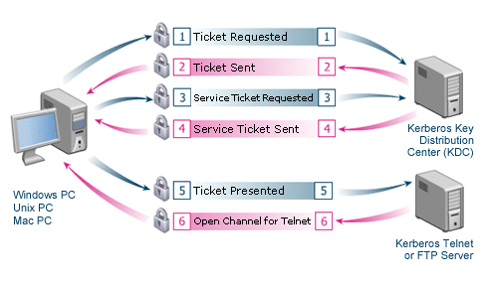
Kerberos – contd.
Essential configuration
Administrator adds client system to “realm”
Basis for confidence in identity
Key distribution server in realm
Authenticates client system and grants resource access
As “tickets”
Ticket presented to service
E.g. printer
Service trusts ticket
Without verification with KDC

Slide 30
Kerberos – contd.
Advantages
High degree of confidence in identity
Initiated by corporate system administrators
Publicly available technology
Like TCP, IP
Inexpensive
Robust
Disadvantages
Not usable on web
No shared “realm”
How can you be confident of identity presented by Amazon’s web server
Or, how can Amazon be confident about your laptop’s identity?

Slide 31
Web authentication systems
Kerberos limitations
No concept of a realm on web
Why should university systems accept service tickets issued by Amazon
Or Google, or Microsoft etc?
Two forms
Token based
Client and server trust a central token provider
Like Kerberos key distribution service
But not each other
Federation based
User-specified mapping between accounts on different services

Slide 32
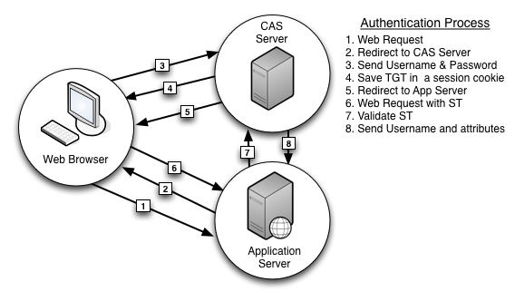
Token-based web authentication
Central authentication service
CAS
Developed at Yale, 2001
Popular in educational institutions
Similar to Kerberos in use of ticket
But server does not trust client
Hence transactions 7 and 8
Verify with CAS server

Slide 33
Federation-based web authentication
Bridging the gap between authentication systems in separate organizations
Use case
Researchers at start-up firm
Firm affiliated with university
101 solution
Two separate accounts for each researcher at start-up
Problems
Unnecessary sharing of confidential information between university and firm
For account creation
Researcher is fired from firm
How does the university know to revoke access?

Slide 34
Federation solution
Only one account
At primary location
Start-up in example
Other locations trust identity verification provided by primary location
Called identity provider
In our example, when user from start-up requests access to university resource
University system directs user to start-up for authentication
University system trusts authentication provided by start-up

Slide 35
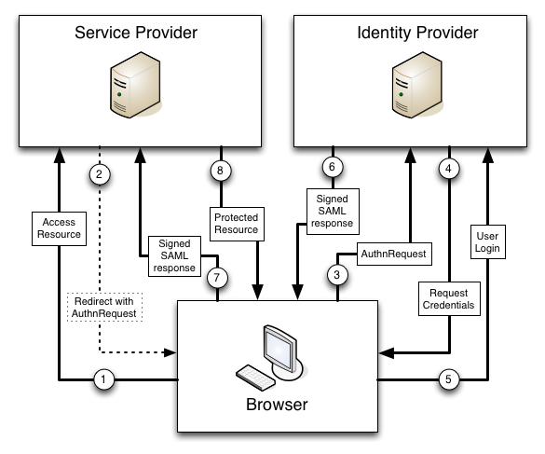
Federation operation
SAML used to exchange authentication information
Security assertion markup language
Similar to token exchange
SAML-based federation may be seen as a flexible CAS
Organizations can choose CAS providers
How is Federation different from Single Sign-On?

Slide 36
Discovery service
Should every institution trust every identity provider?
Discovery service
Provides users with a list of trusted organizations they can choose from to authenticate

Slide 37
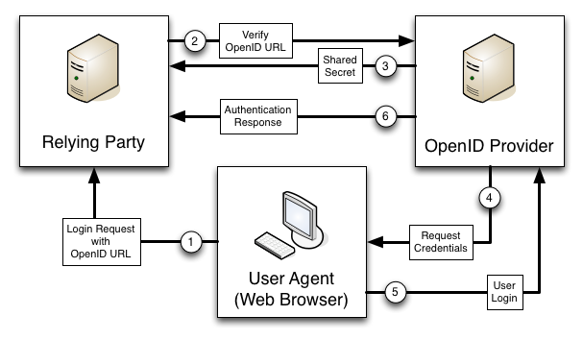
OpenId
Further generalization of federation
User can select Id provider
No special configuration at relying party’s end
Does not receive SAML response from client
Directly receives authentication confirmation from Id provider

Slide 38
Authorization
What if you want to be able to access certain specific resources from a secure site
Open authorization
Mechanism that allows a user to grant access to private resources on one site (the service provider) to another site (the consumer)

Slide 39
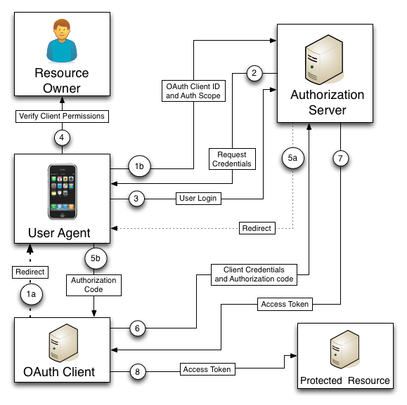





OAuth
Mobile application can access information from a secure site

Slide 40
Chapter Review Questions
What is identity management?
Briefly describe the phases of the identity management model.
What is a System of Record?
Would a person’s name be a good identifier for a System of Record? Why or why not?
What role does the Person Registry play in the identity management process?
What is a role?
What is separation of duties?
Give an example of role-based access control policy.
What do access audits do?
What is a credential?
What are the three categories of credentials?
What is the oldest and simplest form of credential?
What is the difference between a dictionary and brute- force password attack?

Slide 41
Chapter Review Questions
Name one advantage and disadvantage for each of these types of credentials: Password, Smart card, Hardware token, Mobile phone (SMS) software token, Biometric comparison
What are the seven factors that should be considered when determining the suitability of a biometric marker?
Name and briefly describe three advantages and disad- vantages to single sign-on.
What is the name of Microsoft’s single sign-on architecture?
What is an authentication token?
Name at least one advantage and disadvantage to using: Shared tokens, CAS, Shibboleth, OpenID, Oauth
Name at least one similarity in design that CAS and Kerberos share.
What is the purpose of a federation?
Where was the first of the major SAML federations established? What was it called?
Name and briefly describe the four roles in an SAML federation.
Describe two ways that the OpenID 2.0 differs from the OpenID 1.0 specification.
What is a web mashup? Why are they reliant on OAuth for functionality?

Slide 42
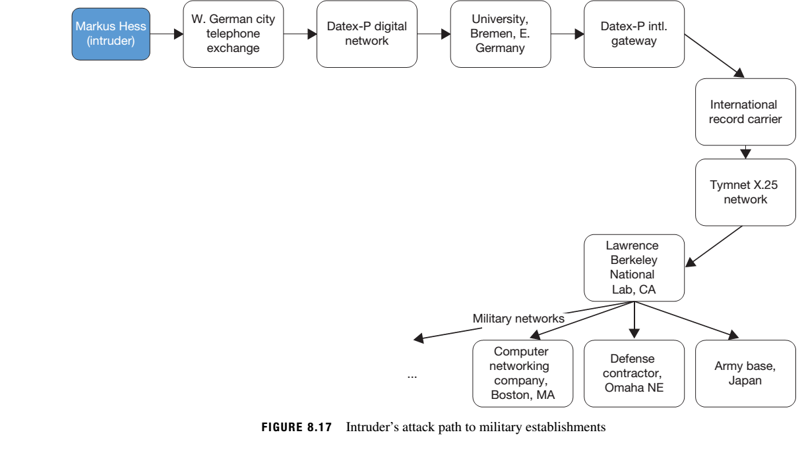
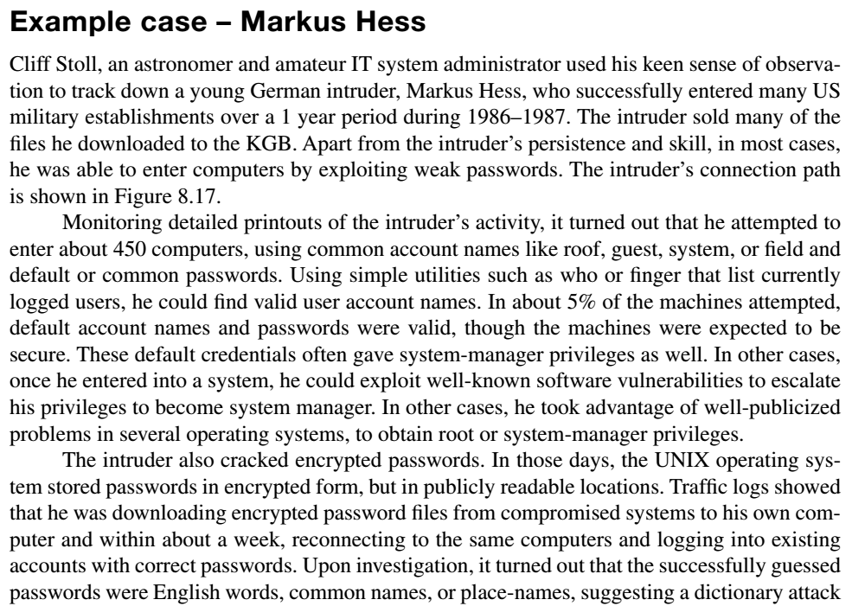
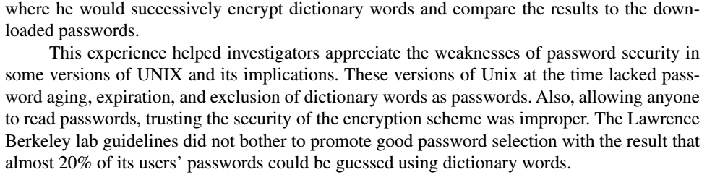
Example case: Markus Hess

Slide 43
Example Case Questions
What are some of the activities that the Lawrence Berkeley labs are currently engaged in?
What in your opinion may be the most valuable items of information an attacker may gain from improperly accessing computers at these labs?
What are the steps currently being taken by the labs to reduce the likelihood of such compromises? (you should be able to find this information online)
What is the operating system you use the most?
How do you view all user accounts and their properties on this operating system?
Do you see any default user accounts on your system (guest, administrator, etc.)?
If there are any such accounts, do you see any poten- tial vulnerabilities on your computer as a result of these accounts?
If you answer yes to the above, what can you do to fix these vulnerabilities?

Slide 44
Summary
Differentiate between identity management and access management
Identify the phases in identity and access management models
Describe the three categories of user credentials
Utilize the relative strengths and weaknesses of the major authentication technologies
Use identity reconciliation as part of the identity management process

Slide 45
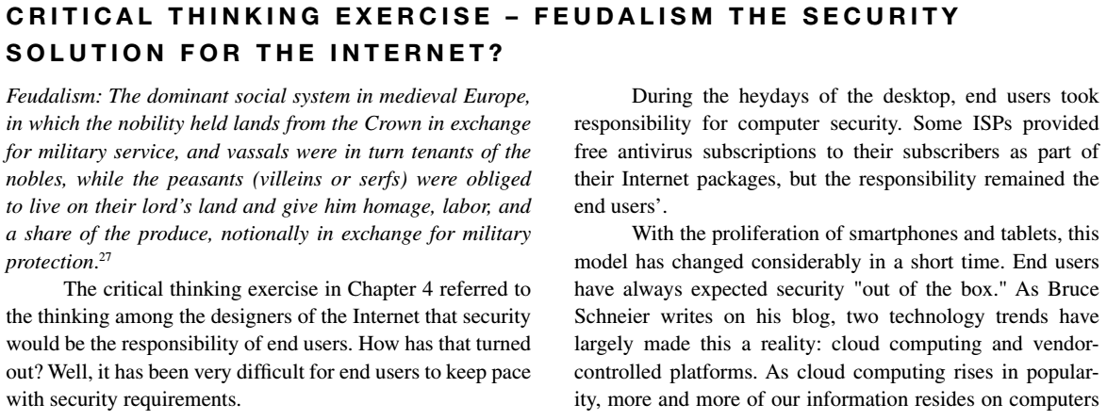
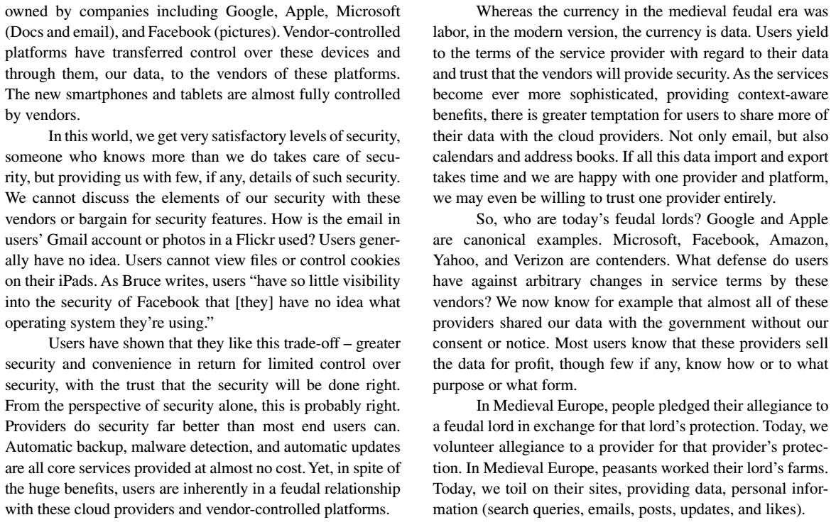
Critical Thinking Exercise

Slide 46
Critical Thinking Exercise Questions
Do you agree with the parallels drawn by Bruce Schneier between feudalism in medieval times and the relation- ship of modern technology users to large providers such as Google and Apple?
Bruce Schneier thinks that government intervention is “the only way” to fix the asymmetric power relationship between the large providers and end users in today’s technology world. In light of the revelations of the US government’s own controversial data monitoring of US citizens, do you agree with this assessment?
Do you think the free market can alleviate some of Bruce Schneier’s concerns?

Slide 47
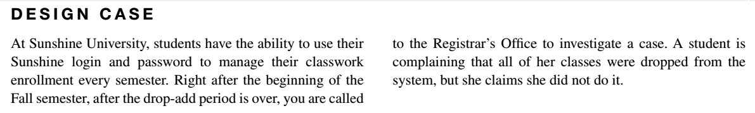
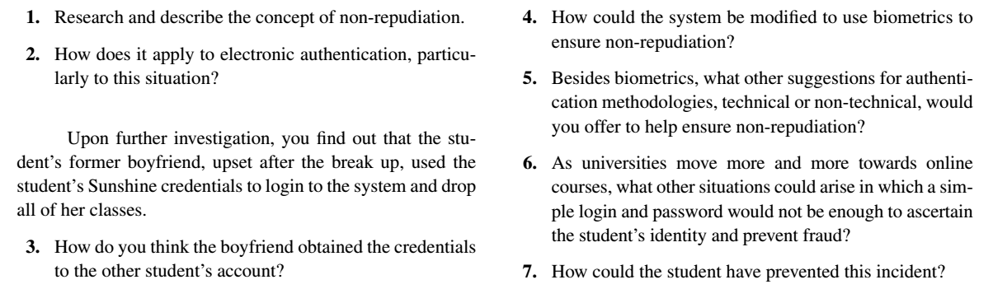
Design Case

Slide 48
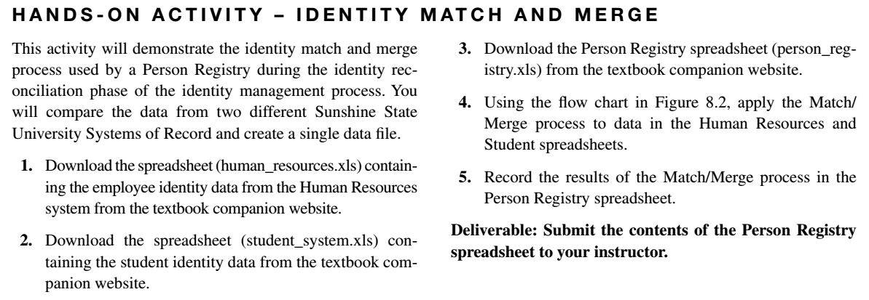
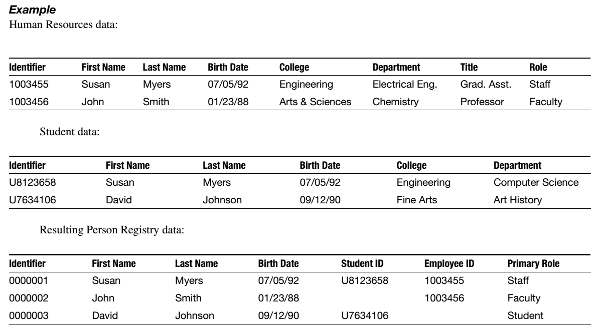
Hands-on Activity (1)

Slide 49
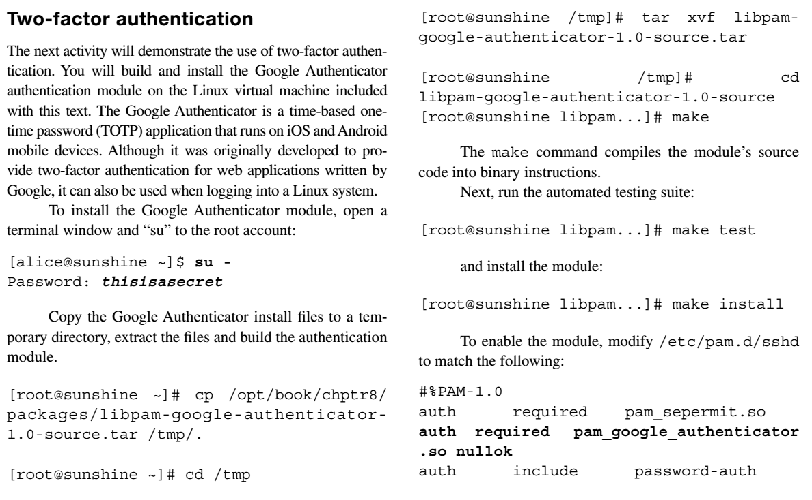
Hands-on Activity (2)

Slide 50
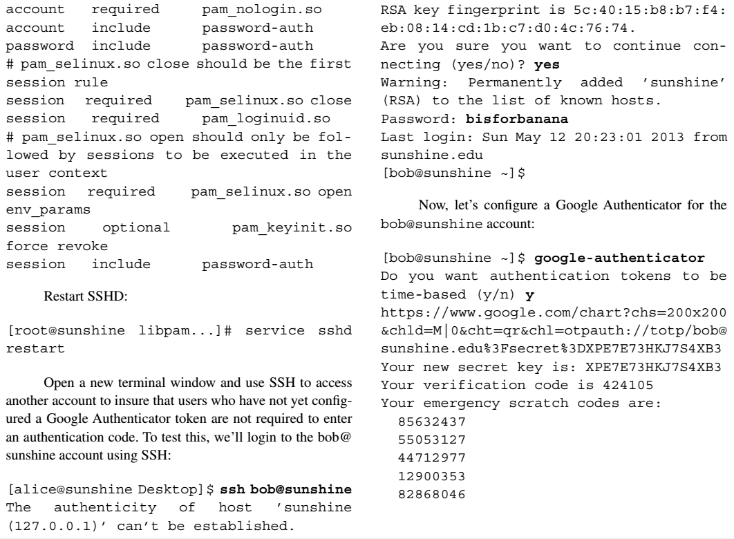
Hands-on Activity (3)

Slide 51
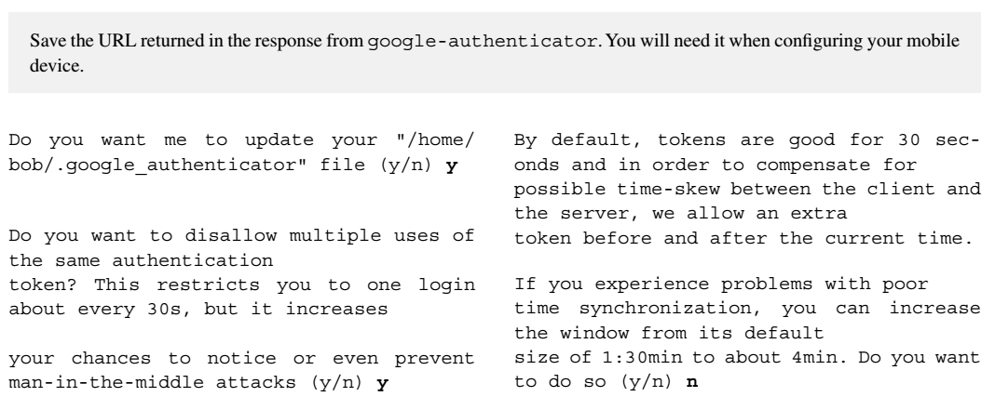
Hands-on Activity (4)

Slide 52
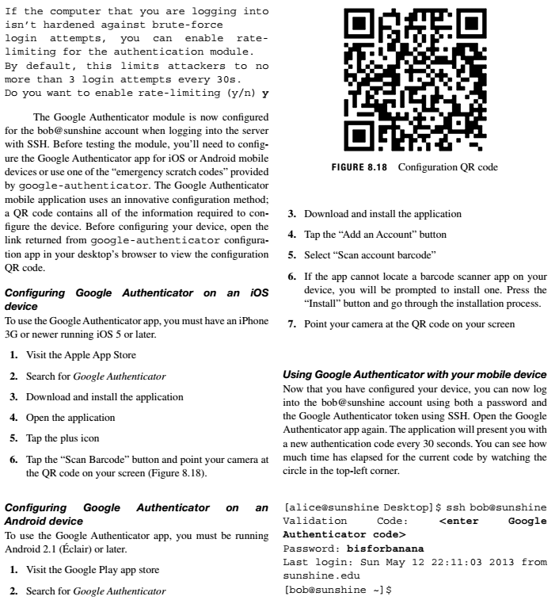
Hands-on Activity (5)

Slide 53
Discussion 8
POST (due WED 11:59 pm CST): Go to Lynda.com and complete the course “Identity and Access Management”. When you have completed the course, upload your Completion Certificate to this Discussion prompt. To find your Completion Certificate, pull down the menu by the user icon and select “Certificates,” then click on “view/print” next to the certificate for Identity and Access Management, print it to .pdf, and upload with your answer to the following question: If you were the Risk Manager for Valparaiso University, what top three password attack vectors should you anticipate, and what countermeasures should you put in place to protect your company’s assets?
RESPONSES (due FRI 11:59 pm CST): Respond to two of your peers' posts—are the attack vectors they have described really the top three? And in what context will the countermeasures they have suggested fail?

Slide 54
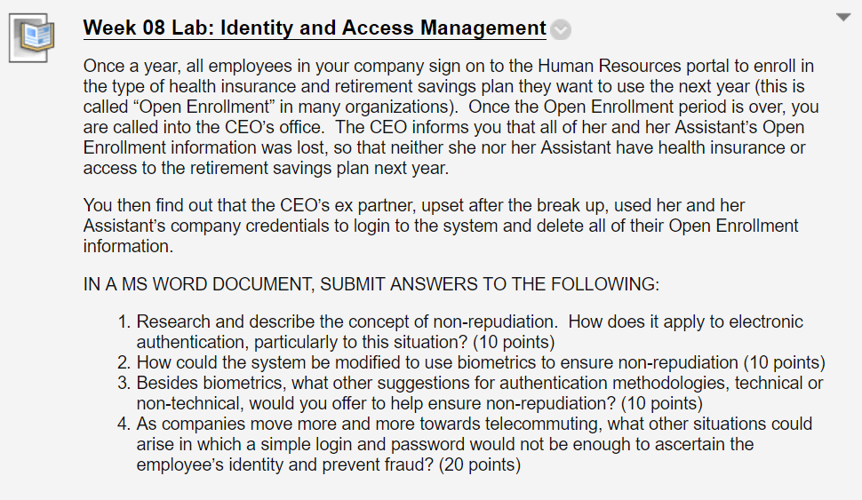
Homework Lab_8

Slide 55
For Next Week
# | Topic | Reading | Due 11:59 pm CST on Blackboard
9 | Hardware and Software Controls (1): Password management, Access control, Firewalls | Agrawal 9 Other materials on Blackboard | W: Post F: Responses S: LAB_9

